Slide 1
Religions of Ancient India
9-2

Slide 2
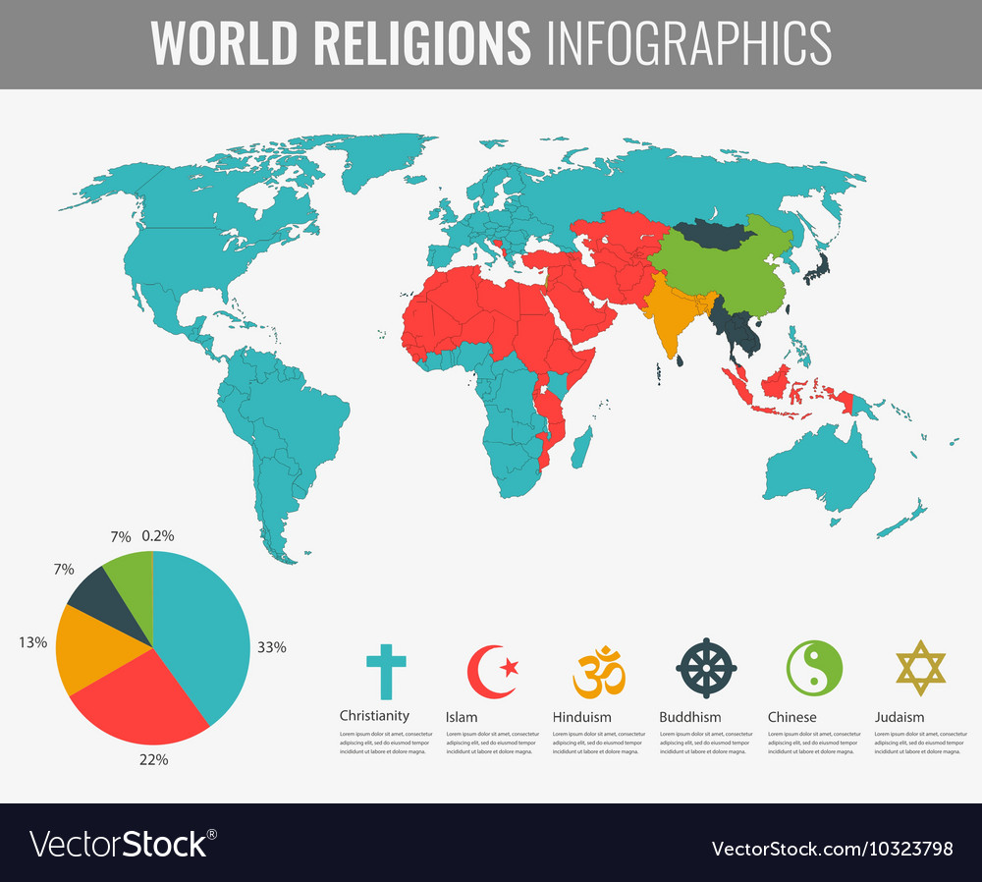
Hinduism
One of the oldest religions
1 – Christianity
2 - Islam
3 – Hinduism
Aryan religion blended with ideas from India

Slide 3
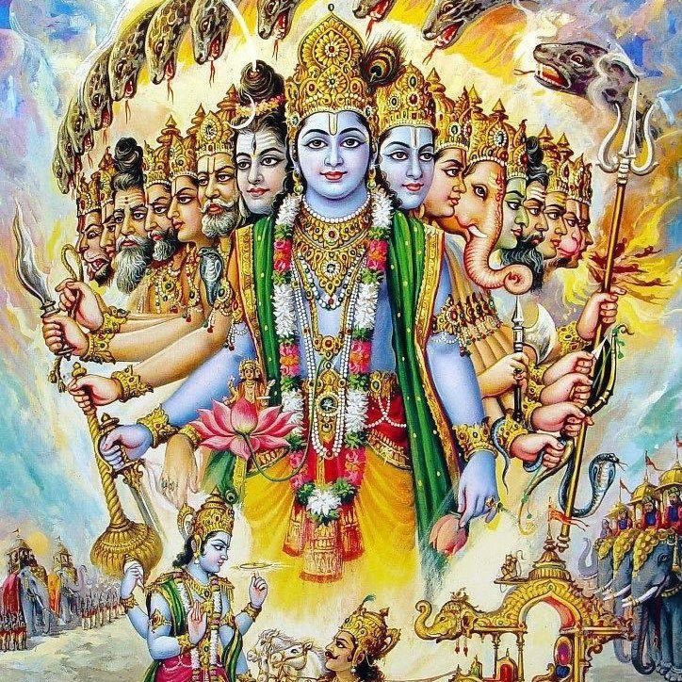
Brahman – one universal spirit
Upanishads – ancient texts

Slide 4
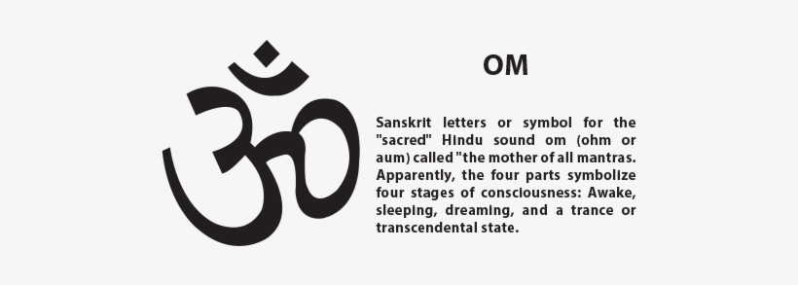
Every living thing has a soul and is part of the Brahman
At death – soul leaves the body and joins with Brahman

Slide 5
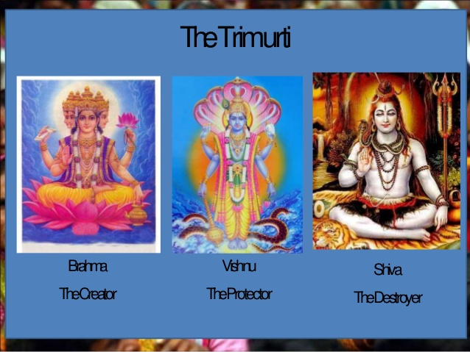
Parts of the Universal Spirit
Deities – gods or goddesses
Brahma – Creator
Vishnu – Preserver
Shiva – Destroyer
All parts of Brahman

Slide 6
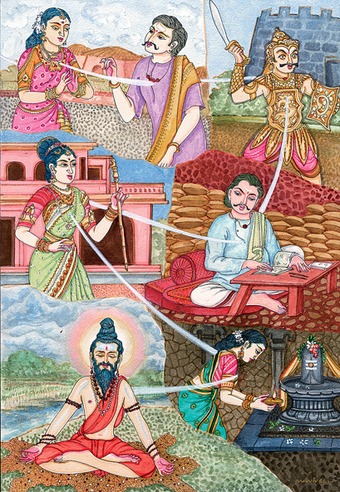
Reincarnation
Rebirth of the soul
Each soul must pass through many lives to reach moksha

Slide 7
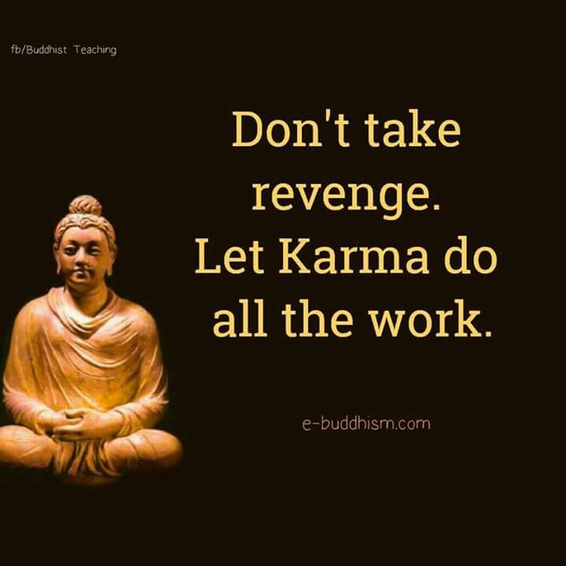
Karma – your status in life is not an accident
  Based on past lives
Good = reborn into better life
Bad = reborn into worse life

Slide 8

Dharma – personal duty
Duties are different depending on who you are in society

Slide 9
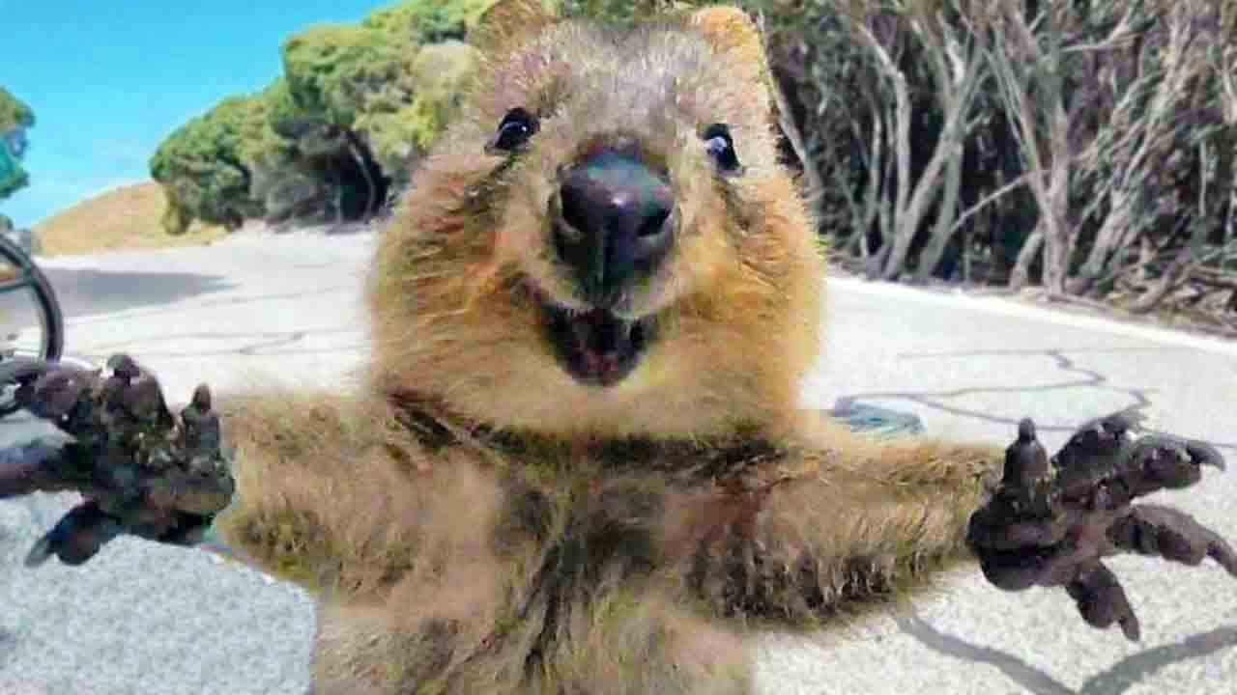
Life is sacred
People and animals should be treated with kindness and respect
Hope for a different kind of life
  Reincarnation

Slide 10
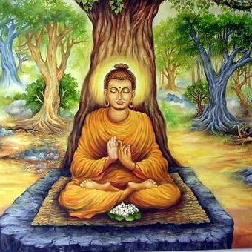
Buddhism
Some Indians wanted a simpler, more spiritual faith
Looked for peace through mediation
Siddhartha Gautama – Buddha
  Founded new religion

Slide 11
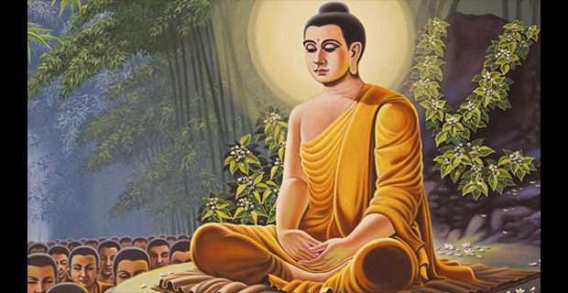
Rich, handsome, happily married, newborn son
Left his palace and realized the world was full of suffering
Gave it all up and became a monk.
  Left wife and son and tried to find the meaning of life

Slide 12
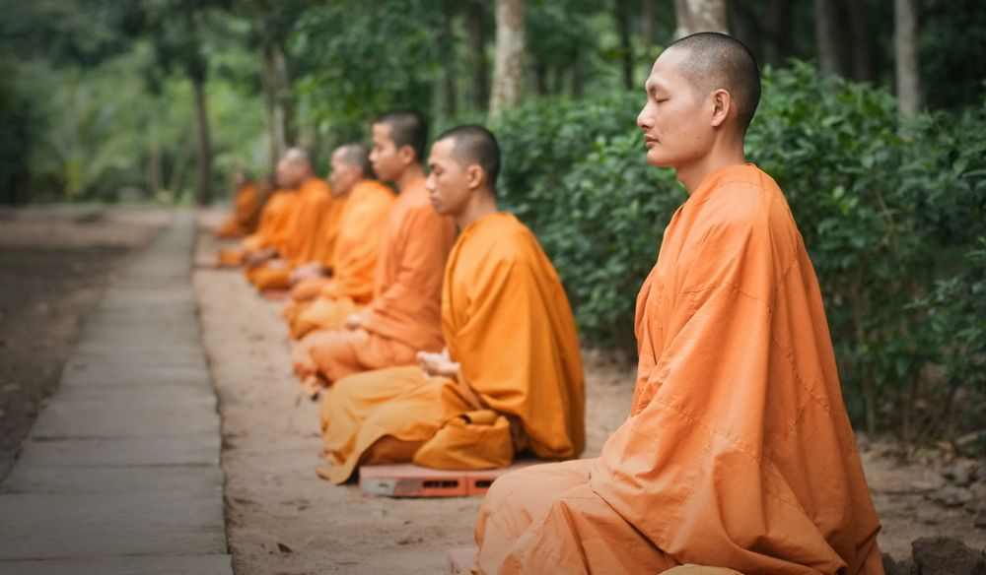
Buddha’s teaching became known as Buddhism
Seeking spiritual truth will lead to inner peace
Give up all desires

Slide 13
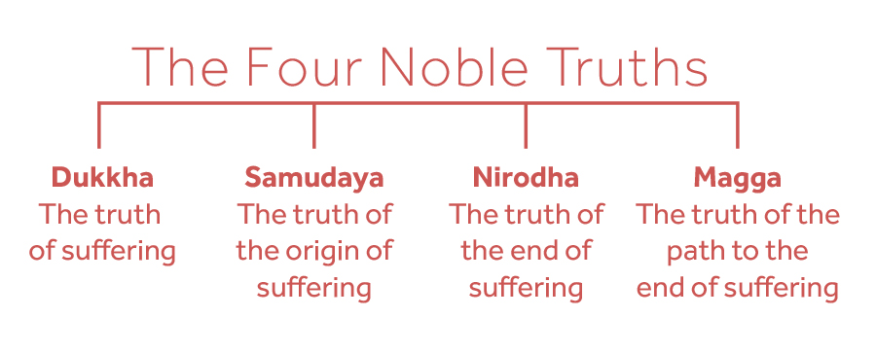
4 Noble Truths
Helps to seek spiritual truth.
1. Life is full of suffering
2. People suffer because they desire worldly things
3. The way stop suffering is to stop desire
4. To stop desire you must follow the Eightfold Path

Slide 14
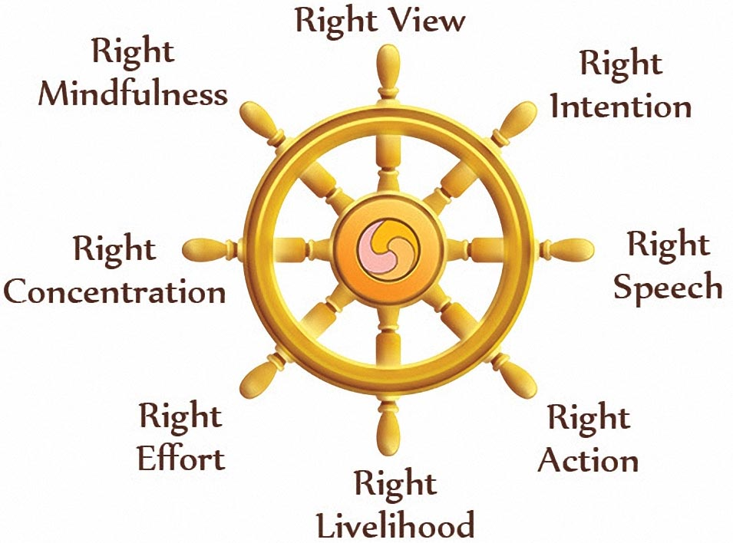
Eightfold Path
People can end suffering by following these steps.
1. Know the 4 Noble Truths
2. Give up worldly things, don’t harm others
3. Tell the truth, don’t gossip or speak badly of others
4. No evil acts (killing, stealing, unclean life)

Slide 15
5. Do rewarding work
6. Work for good, oppose evil
7. Make sure your mind keeps your senses under control
8. Meditate to see the world in a new way

Slide 16
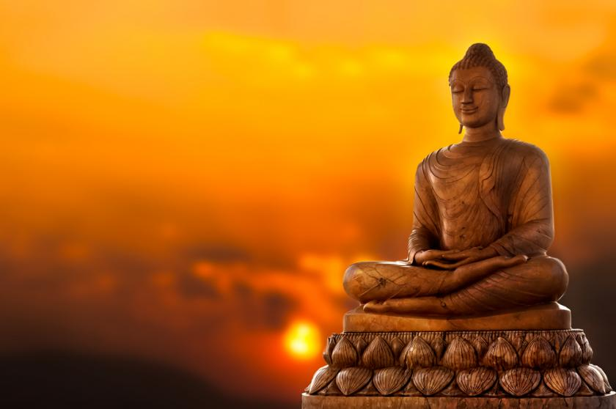
Nirvana - Emotional or spiritual state of perfect happiness
Did not follow varna system
Can end reincarnation by following Eightfold Path

Slide 17
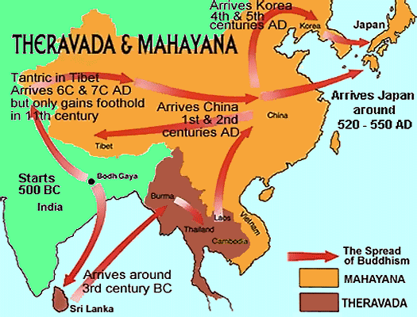
After Buddha’s Death
2 groups that spread religion
Theravada – did not view Buddha as a god
Mahayana – Buddha is a god

Slide 18

Jainism
Mahavira – religious leader
Jains – followers
Practiced strict poverty

Slide 19
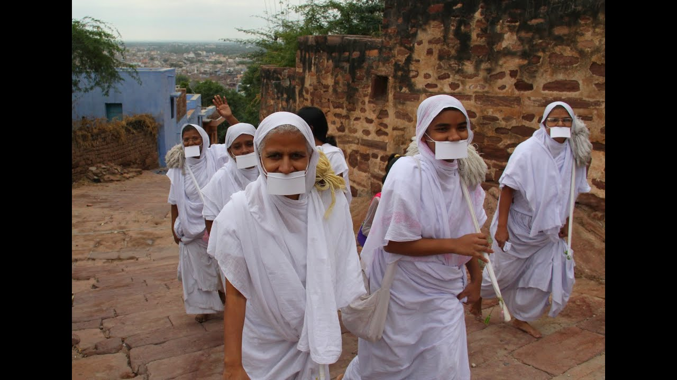
Ahimsa – nonviolence towards all living things
Sweep away bugs
No farming – hurt worms

